Slide 1
Elevate Your Lifestyle with Our Mobile Technology
MOBILE SECURITY
PRESENTATION
BY GANESH

Slide 2
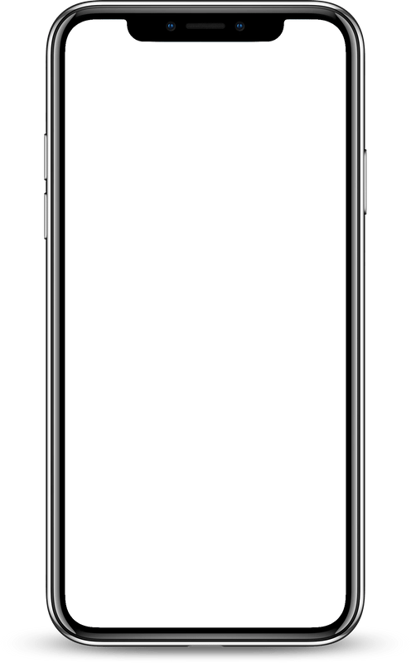

A Simple, Yet
Effective Way to Be More Productive.
Before Smartphone - applications only run on PC endpoints or on physical servers in data center
Mobile security is crucial in today’s digital landscape. As we rely more on our smartphones for communication, banking, and personal data storage, protecting our devices becomes paramount.
Digital World

Slide 3

Main Rules Organisation follows are
Growing use of mobile devices - combination of end point devices for day to day activities
Cloud based applications - previously applications used to run only on physical servers in data centers but now most of the applications run on all devices Like zoom and Microsoft teams are used to conduct meetings between clients who are present in long distance

Slide 4
Main rules organisation follows are
Deperimeterisation - application mobility, dynamic perimeters, these dynamic perimeters must be able to adapt to environment factors
External requirements organisation should be able to provide network access to 3rd party contractors, business partners

Slide 5
Security Threats
Lack Of Physical Controls
Use of location services
Interaction with other systems
Use of untrusted applications
GPS capability on mobile devices can be useful as part of presence service
Use of untrusted networks
Theft and tampering 2 possibilities - malicious injection and access organisation resources
mobile devices has ability to synchronise apps with cloud based storage, there is considerable risk of organisation data being stored in unsecured location
many of the third party applications may not be trustworthy.
network connections outside of organisation cannot be trusted there is very much possibility of man in the middle attacks

Slide 6
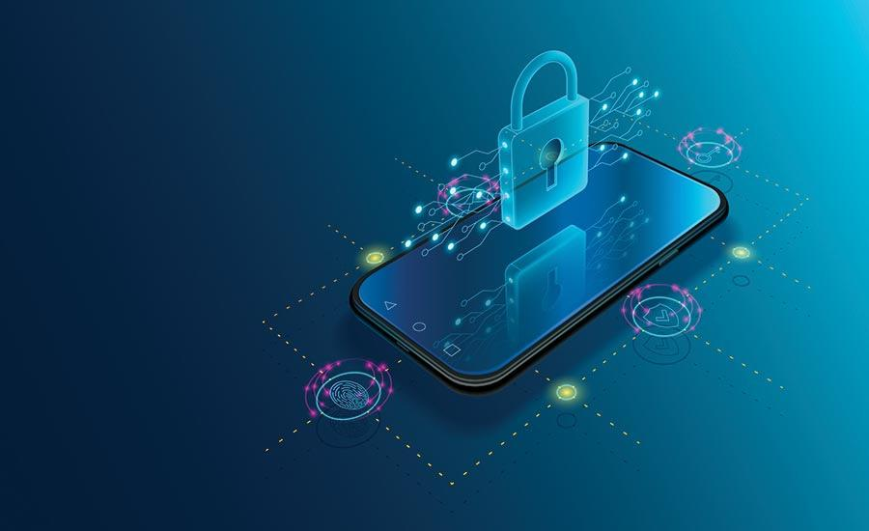
DEVICE SECURITY
A number of organizations will supply mobile devices for employee use and preconfigure those devices to conform to the enterprise security policy many organizations will find it convenient or even necessary to adopt a bring-your-own-device (BYOD) policy that allows the personal mobile devices of employees to have access to corporate resources.

Slide 7



Whether a device is owned by the organization or BYOD, the organization should configure the device with
security controls, including the following:
Enable password or PIN protection
Enable auto-lock
Device Security
Avoid using auto-complete features
Enable remote wipe
Software used should be up to date
Ensure that SSL protection is enabled, if available

Slide 8
sensitive data should not be stored or should be encrypted before stored
The organization may prohibit all installation of third-party applications
Device Security
The organization can implement and enforce restrictions on what devices can synchronize and on the use of cloud-based storage.

Slide 9

Traffic Security
Traffic security is based on the usual mechanisms for encryption and authentication. All traffic should be encrypted and travel by secure means, such as SSL or IPv6. Virtual private networks (VPNs) can be configured so that all traffic between the mobile device and the organization’s network is via a VPN.

Slide 10
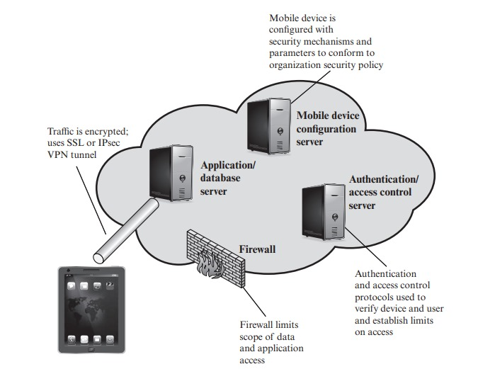

Slide 11
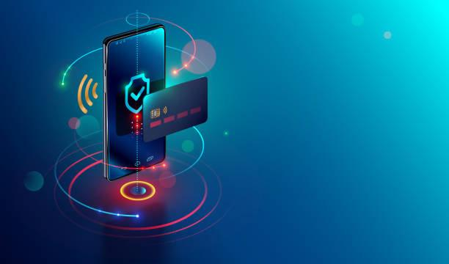
BARRIER SECURITY
The organization should have security mechanisms to protect the network from unauthorized access. The security strategy can also include firewall policies specific to mobile device traffic. Firewall policies can limit the scope of data and application access for all mobile devices. Similarly, intrusion detection and intrusion prevention systems can be configured to have tighter rules for mobile device traffic.

Slide 12
Thank You

